Slide 1
Daily climate data DAYCLI
WIS 2.0 Training Workshop, Windhoek, Namibia, 20-24 March 2023​
David Inglis Berry
Climate Data Officer

Slide 2
Daily climate reports (DAYCLI)
Requirement for daily climate observations to monitor extremes
Daily observations of
Minimum, maximum and average temperature over 24 hour period
Total accumulated precipitation over 24 hour period
Total snow depth at time of observation
Depth of fresh snow over 24 hour period
Recognition of different reporting practices by Members, explicit reporting of 24 hour period used
Additional metadata: method of calculating average temperature; sensor and station heights; exposure and measurement quality classification

Slide 3
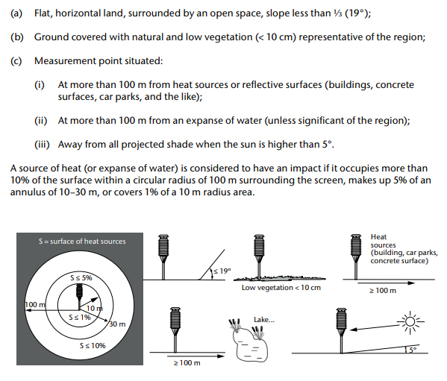
Sensor siting and exposure quality
Guidance on the siting of thermometer screens given in WMO-No. 8, the “Guide to Instruments and Methods of Observation”.
Siting and exposure quality ranked on scale 1 – 5, this information is included in the DAYCLI data.
This information should also be included in the WMO OSCAR/Surface record for the stations.
Example of siting and exposure = 1 for air temperature and humidity

Slide 4
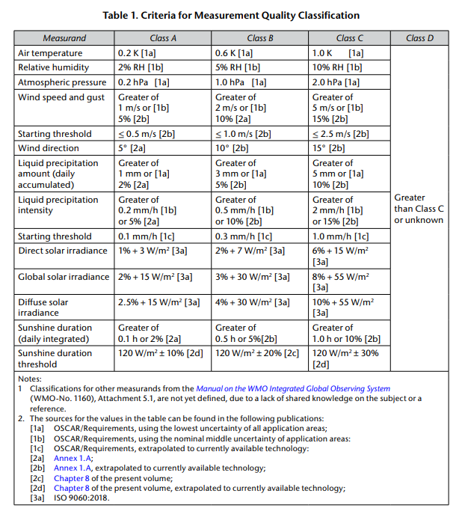
Sensor measurement quality
Guidance on measurement quality and uncertainty also provided in WMO-No. 8.
Example on right shows the current classification .
Measurement quality ranked on scale A (best) – D (worst, unclassified).
These are based on current WMO OSCAR requirements and may change in the future.
Within the DAYCLI data the sensor siting and measurement quality are combined, e.g. 1A, 3B, etc, and enumerated.

Slide 5
Reporting practices
Historical reporting practices for climate data have historically varied across members,
e.g. use of daily minimum temperature over period 18:01 the preceding day to 18:00 on the day of observation vs 00:01 on the day of observation to 00:00 the following day.
Days / times vary by Member and observed parameter
For each parameter the start day and time is given:
Day given by either
-1 indicating that the 24 hour period starts on the preceding day, or
0 indicating that the 24 period starts on the day of observation.
Time given by the hour, minute and second (UTC) of the start of the observing period
E.g. minimum temperature observed over period 2023/04/22 18:00:01 to 2023/04/23 18:00:00
Period start given by day = -1, start time = 18:00:01
Reporting day given by 2023/04/23
Different methods used for calculating average temperature, method included in the DAYCLI data
E.g., average of min/max temperature, averaging of 3-hourly values, average of minute data from AWS etc.

Slide 6
Method of averaging temperature
0: average of minimum and maximum temperatures
1: Average of 8 tri-hourly observations
2: Average of 24 hourly observations
3: Weighted average of three observations
4: Weighted average of three observations, as well as the minimum and maximum values
5: AWS complete integration from minute data
6: Average of 4 six-hourly observations

Slide 7
Quality control
Daily climate data should be quality flagged before exchange
Valid flags are:
Flag | Meaning | Flag | Meaning
0 | Data checked and declared good | 4 | Data checked and declared aggregated and out of instrument range
1 | Data checked and declared suspect | 5 | Parameter is not measured at the station
2 | Data checked and declared aggregated | 6 | Daily value not provided
3 | Data checked and declared out of instrument range | 7 | Data unchecked
Aggregate flags are included for when the precipitation is collected over more than 24 hours, e.g. due to issues in reading and resetting the gauges.
Lower bound flags are important for extremes, particularly when a gauge may overflow. These flags provide a mechanism to record (and flag) the lower limit.

Slide 8
DAYCLI encoding
CSV2bufr includes the ability to transform CSV DAYCLI data to BUFR
As with the other CSV2bufr a BUFR mapping template is required
Example CSV file layout given on the following two slides

Slide 9
Example CSV2bufr input file layout
Column | Description
wsi_series | WIGOS Identifier series, set to 0 for stations
wsi_issuer | WIGOS Identifier issue, ISO 3 digit (number) country code or 20000 series
wsi_issue_number | WIGOS Identifier issue number
wsi_local_identifier | WIGOS Identifier local identifier, alphanumeric, max 16 characters
wmo_block_number | WMO block number for station 0 - 99
wmo_station_number | WMO station number 0 - 999
latitude | Latitude of station, high precision (5 d.p.)
longitude | Longitude of station, high precision (5 d.p.)
station_elevation | Height of station above mean sea level (m)
temperature_siting_classification | Combined sensor siting and measurement quality classification (temperature)
precipitation_siting_classification | Combined sensor siting and measurement quality classification (precipitation)
averaging_method | Method used to calculate daily average temperature
year | Year (UTC) of nominal reporting day
month | Month (UTC) of nominal reporting day
day | Day (UTC) of month for nominal reporting day
precipitation_day_offset | Start of reporting period for precipitation, offset in days relative to nominal reporting day (-1 or 0)
precipitation_hour | Beginning hour (UTC) over which the precipitation is measured
precipitation_minute | Beginning minute (UTC) over which the precipitation is measured
precipitation_second | Beginning second (UTC) over which the precipitation is measured
precipitation | Total accumulated precipitation over indicated 24 hour period (kg m-3, equivalent to mm)
precipitation_flag | Quality control flag for total accumulated precipitation
fresh_snow_day_offset | Start of reporting period for fresh snow depth, offset in days relative to nominal reporting day (-1 or 0)
fresh_snow_hour | Beginning hour (UTC) over which the fresh snow depth is measured
fresh_snow_minute | Beginning minute (UTC) over which the fresh snow depth is measured
fresh_snow_second | Beginning second (UTC) over which the fresh snow depth is measured
fresh_snow_depth | Fresh snow depth over indicated 24 hour period (m, 2 d.p.)
fresh_snow_depth_flag | Quality control flag for the fresh snow depth

Slide 10
Example CSV2bufr input file layout (cont.)
Column | Description
total_snow_day_offset | Start of reporting period for total snow depth, offset in days relative to nominal reporting day (-1 or 0)
total_snow_hour | Beginning hour (UTC) over which the total snow depth is measured
total_snow_minute | Beginning minute (UTC) over which the total snow depth is measured
total_snow_second | Beginning second (UTC) over which the total snow depth is measured
total_snow_depth | Total snow depth over indicated 24 hour period (m, 2 d.p.)
total_snow_depth_flag | Quality control flag for the total snow depth
thermometer_height_above_ground | Height of thermometer above local ground level (m)
maximum_temperature_day_offset | Start of reporting period for maximum temperature, offset in days relative to nominal reporting day (-1 or 0)
maximum_temperature_hour | Beginning hour (UTC) over which the maximum temmperature is measured
maximum_temperature_minute | Beginning minute (UTC) over which the maximum temperature is measured
maximum_temperature_second | Beginning second (UTC) over which the maximum temperature is measured
maximum_temperature | Maximum temperature over indicated 24 hour period (K, 2 d.p.)
maximum_temperature_flag | Quality control flag for the maximum temperature
minimum_temperature_day_offset | Start of reporting period for minimum temperature, offset in days relative to nominal reporting day (-1 or 0)
minimum_temperature_hour | Beginning hour (UTC) over which the minimum temmperature is measured
minimum_temperature_minute | Beginning minute (UTC) over which the minimum temperature is measured
minimum_temperature_second | Beginning second (UTC) over which the minimum temperature is measured
minimum_temperature | Minimum temperature over indicated 24 hour period (K, 2 d.p.)
minimum_temperature_flag | Quality control flag for the minimum temperature
average_temperature_day_offset | Start of reporting period for average temperature, offset in days relative to nominal reporting day (-1 or 0)
average_temperature_hour | Beginning hour (UTC) over which the average temmperature is measured
average_temperature_minute | Beginning minute (UTC) over which the average temperature is measured
average_temperature_second | Beginning second (UTC) over which the average temperature is measured
average_temperature | Average temperature over indicated 24 hour period (K, 2 d.p.)
average_temperature_flag | Quality control flag for the average temperature

Slide 11
DAYCLI encoding (cont.)
If the proposed layout is used the built-in DAYCLI template can be used, e.g.:
>> csv2bufr data transform datafile.csv --bufr-template daycli --output-dir ./
Where datafile.csv is the name of the csv file containing the DAYCLI data.
Other csv files can be used but new BUFR mapping templates will need to be created

Slide 12
Thank you
Merci

